Slide 1
Binary search

Slide 2
Outline
In this lesson, we will:
Determine how to search a sorted list
Define the binary search algorithm
Look at the flow chart for this algorithm
Implement the algorithm based on the flow chart
Test the implementation and look at test cases
Examine the number of steps that must be taken
Describe the implementations in the Standard Template Library

Slide 3
Ordered types
If an array is not sorted, searching it is slow
In the worst case, we must inspect each entry
Guess a number from 1 to 100
If you are only told “yes” or “no”, you must perform a linear search
If you are playing high-low, you can now become more efficient:
First, guess 50
If this is too high, guess 25; otherwise, guess 75
At each step, you guess the mid-point between the two possible extremes

Slide 4
Binary search
Suppose we are searching an array a for a value x that may be between two indices: m and n
If m = n, there is only one cell to check, so check if a_{m} = x and return the capacity if it is not, otherwise, return m
Otherwise, let ,
If a_{ℓ} = x, we are done: return ℓ;
Otherwise, if a_{ℓ} > x, we need to search the left half: let n ← ℓ – 1
Otherwise, a_{ℓ} < x so we need to search the right half: let m ← ℓ + 1
Return to Step 1

Slide 5
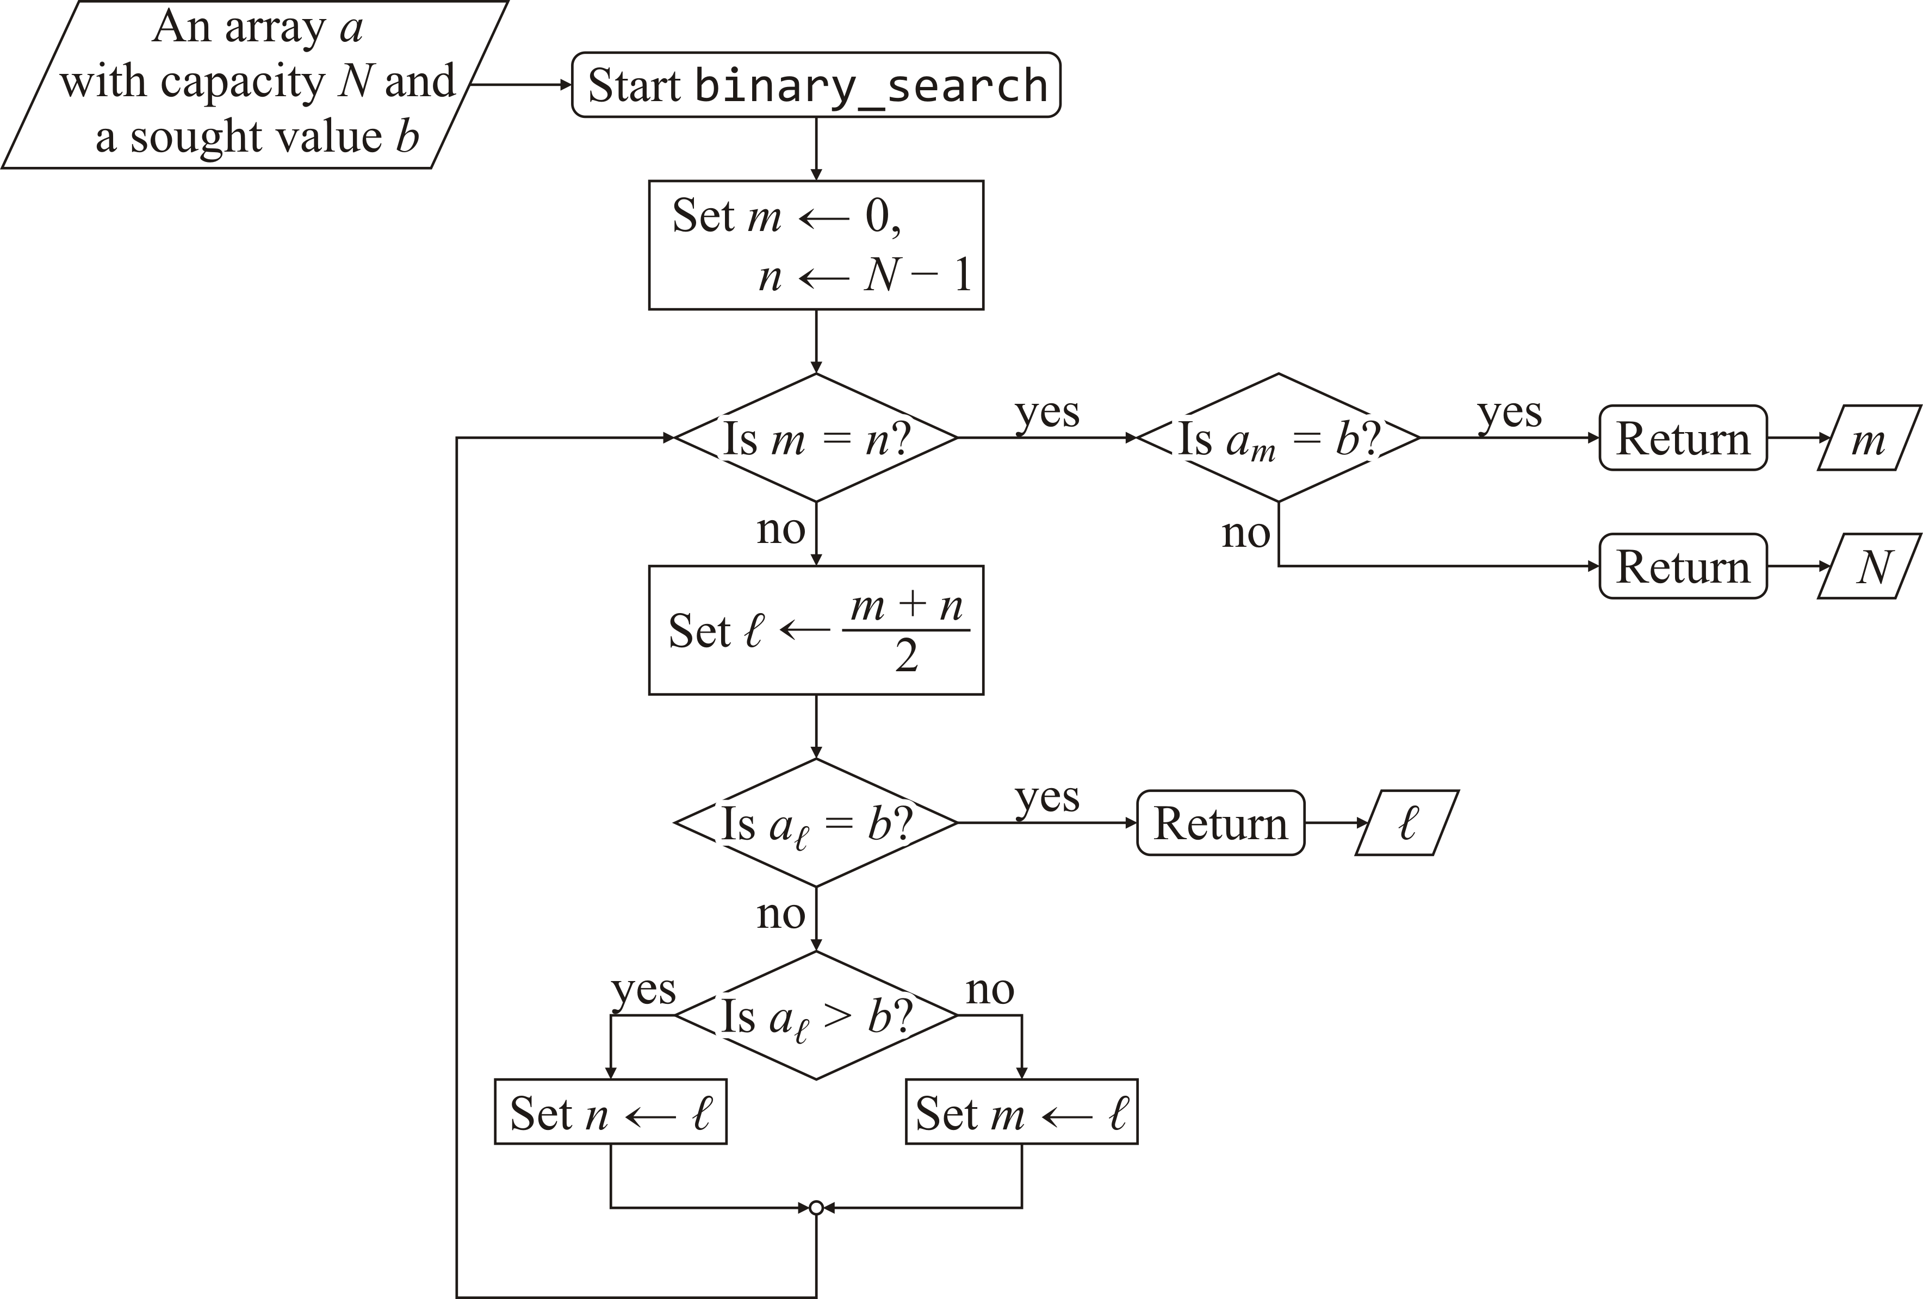
Binary search
Here is the flow chart

Slide 6
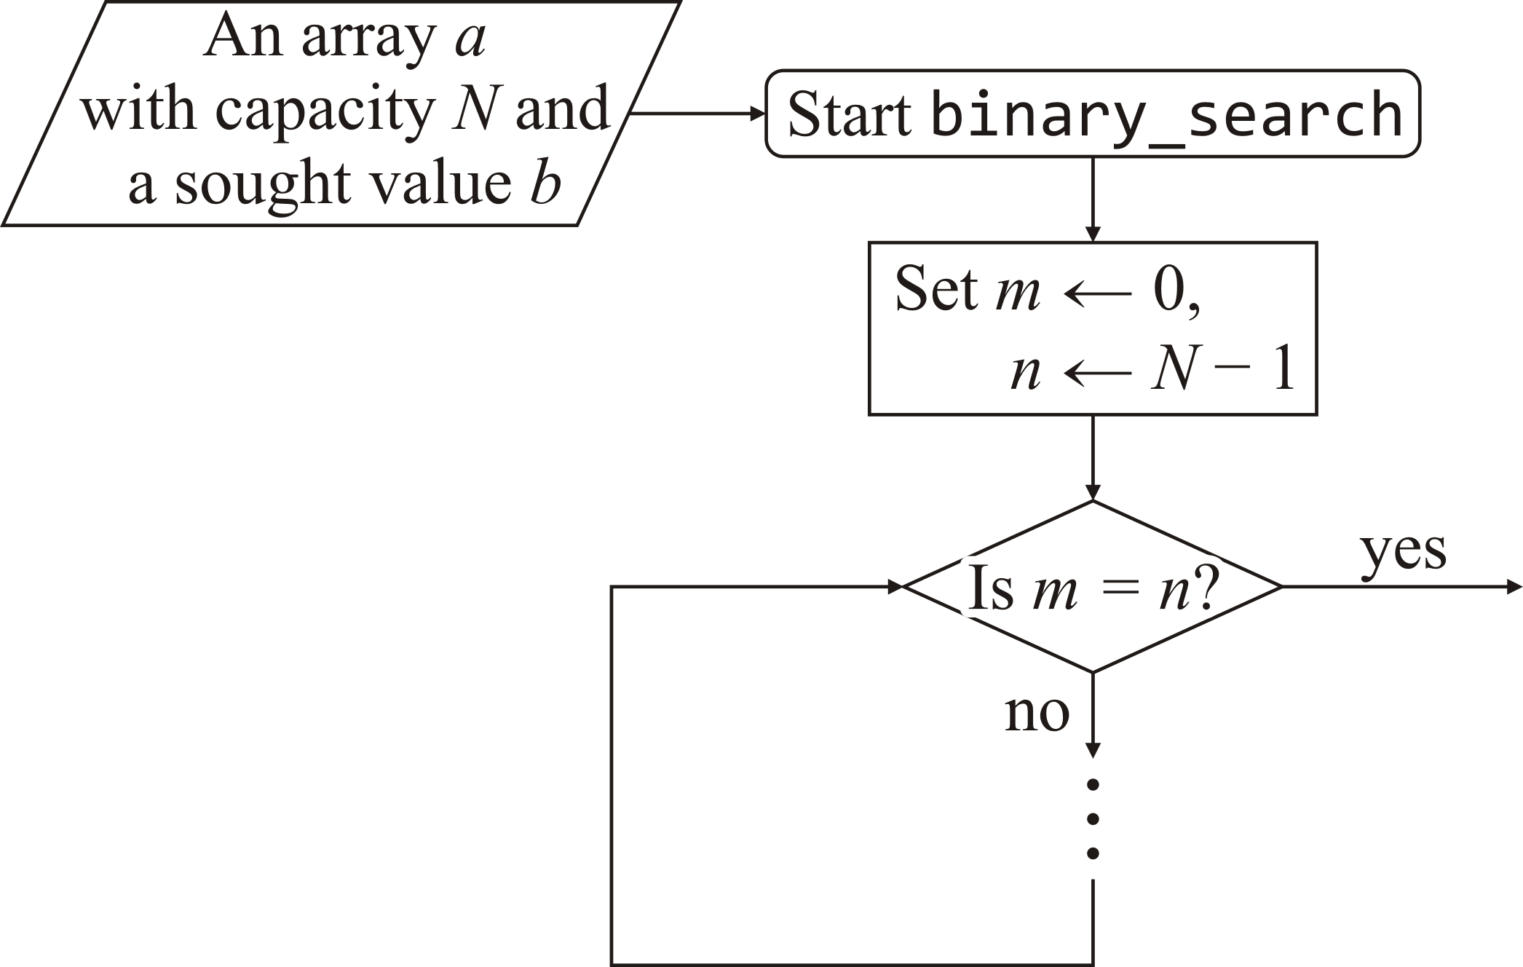
Binary search
We have a loop, but what is the problem?
This is not a while loop
The complementary operator of m = n is m ≠ n

Slide 7

Binary search
Now we have the form of a while loop:

Slide 8

Binary search
Let us start with some reasonable local variables
std::size_t binary_search( double const array[],
std::size_t const capacity,
double const sought_value ) {
std::size_t left{0};
std::size_t right{capacity - 1};
}

Slide 9
Binary search
Next, let us include the while loop
std::size_t binary_search( double const array[],
std::size_t const capacity,
double const sought_value ) {
std::size_t left{0};
std::size_t right{capacity - 1};
while ( left != right ) {
}
}

Slide 10
Binary search
Note that both of these are equivalent:
// If they are equal, 'left' is returned,
// otherwise, they are unequal and 'capacity' is returned
if ( array[left] == sought_value ) {
return left;
} else {
return capacity;
}
// If they are equal, 'left' is returned,
// otherwise, they are unequal and 'capacity' is returned
return (array[left] == sought_value) ? left : capacity;

Slide 11
Binary search
When the while loop ends, we have to check that entry
std::size_t binary_search( double const array[],
std::size_t const capacity,
double const sought_value ) {
std::size_t left{0};
std::size_t right{capacity - 1};
while ( left != right ) {
}
return (array[left] == sought_value) ? left : capacity;
}

Slide 12
Binary search
We determine the mid-point:
std::size_t binary_search( double const array[],
std::size_t const capacity,
T const sought_value ) {
std::size_t left{0};
std::size_t right{capacity - 1};
while ( left != right ) {
std::size_t midpoint{(left + right)/2};
}
return (array[left] == sought_value) ? left : capacity;
}

Slide 13
Binary search
We either return or update based on the relationship
std::size_t binary_search( double const array[],
std::size_t const capacity,
double const sought_value ) {
std::size_t left{0};
std::size_t right{capacity - 1};
while ( left != right ) {
std::size_t midpoint{(left + right)/2};
if ( array[midpoint] == sought_value ) {
return midpoint;
} else if ( array[midpoint] > sought_value ) {
right = midpoint - 1;
} else {
left = midpoint + 1;
}
}
return (array[left] == sought_value) ? left : capacity;
}
Cascading conditional statements

Slide 14
Binary search
You could include an assertion to ensure that another programmer does not adversely change the code
if ( array[midpoint] == sought_value ) {
return midpoint;
} else if ( array[midpoint] > sought_value ) {
right = midpoint - 1;
} else {
assert( array[midpoint] < sought_value );
left = midpoint + 1;
}

Slide 15
Testing our function
Output:
7
0
7
7
7
7
1
7
7
2
3
7
7
4
7
7
7
5
7
7
7
6
7
To test our function, let’s create an array of integers:
It should be sorted, and we should vary the spacing between the entries
Let’s pick an array capacity of 7
int array[7]{1, 6, 9, 10, 13, 17, 21};
Next, let us attempt to find every integer between 0 and 22:
std::size_t tmp;
for ( int k{0}; k <= 22; ++k ) {
std::cout << binary_search( array, 7, k )
<< std::endl;
}

Slide 16
Testing our function
Output:
7
0
7
7
7
1
7
7
7
2
3
7
7
4
7
7
7
5
It seems to work:
We should, however, not just try one size of an array:
Let’s pick an array capacity of 8:
int array[8]{1, 6, 9, 10, 13, 17, 21, 29};
Next, let us attempt to find every integer between 0 and 22:
std::size_t tmp;
for ( int k{0}; k <= 30; ++k ) {
std::cout << binary_search( array, 8, k )
<< std::endl;
}
keeps executing…
Problem: it seems to be in an infinite loop…
– It seems that 17 was found
– There seems to be a problem searching for 18…

Slide 17
Testing our function
From the output, we note the search for 18 fails:
int array[8]{1, 6, 9, 10, 13, 17, 21, 29};
Our local variables are initialized:
left: 0
right: 7
while ( left != right ) {
std::size_t midpoint{(left + right)/2};
if ( array[midpoint] == sought_value ) {
return midpoint;
} else if ( array[midpoint] > sought_value ) {
right = midpoint - 1;
} else {
left = midpoint + 1;
}
}
return (array[left] == sought_value);
0 | 1 | 2 | 3 | 4 | 5 | 6 | 7
1 | 6 | 9 | 10 | 13 | 17 | 21 | 29

Slide 18
Testing our function
From the output, we note the search for 18 fails:
int array[8]{1, 6, 9, 10, 13, 17, 21, 29};
We find the mid-point:
left: 0
right: 7
midpoint: 3
while ( left != right ) {
std::size_t midpoint{(left + right)/2};
if ( array[midpoint] == sought_value ) {
return midpoint;
} else if ( array[midpoint] > sought_value ) {
right = midpoint - 1;
} else {
left = midpoint + 1;
}
}
return (array[left] == sought_value);
0 | 1 | 2 | 3 | 4 | 5 | 6 | 7
1 | 6 | 9 | 10 | 13 | 17 | 21 | 29

Slide 19
Testing our function
From the output, we note the search for 18 fails:
int array[8]{1, 6, 9, 10, 13, 17, 21, 29};
Now: array[3] < 18
left: 0
right: 7
midpoint: 3
while ( left != right ) {
std::size_t midpoint{(left + right)/2};
if ( array[midpoint] == sought_value ) {
return midpoint;
} else if ( array[midpoint] > sought_value ) {
right = midpoint - 1;
} else {
left = midpoint + 1;
}
}
return (array[left] == sought_value);
0 | 1 | 2 | 3 | 4 | 5 | 6 | 7
1 | 6 | 9 | 10 | 13 | 17 | 21 | 29

Slide 20
Testing our function
From the output, we note the search for 18 fails:
int array[8]{1, 6, 9, 10, 13, 17, 21, 29};
Thus, we update left:
left: 4
right: 7
midpoint: 3
while ( left != right ) {
std::size_t midpoint{(left + right)/2};
if ( array[midpoint] == sought_value ) {
return midpoint;
} else if ( array[midpoint] > sought_value ) {
right = midpoint - 1;
} else {
left = midpoint + 1;
}
}
return (array[left] == sought_value);
0 | 1 | 2 | 3 | 4 | 5 | 6 | 7
1 | 6 | 9 | 10 | 13 | 17 | 21 | 29

Slide 21
Testing our function
From the output, we note the search for 18 fails:
int array[8]{1, 6, 9, 10, 13, 17, 21, 29};
We find a new value for mid-point:
left: 4
right: 7
midpoint: 5
while ( left != right ) {
std::size_t midpoint{(left + right)/2};
if ( array[midpoint] == sought_value ) {
return midpoint;
} else if ( array[midpoint] > sought_value ) {
right = midpoint - 1;
} else {
left = midpoint + 1;
}
}
return (array[left] == sought_value);
0 | 1 | 2 | 3 | 4 | 5 | 6 | 7
1 | 6 | 9 | 10 | 13 | 17 | 21 | 29

Slide 22
Testing our function
From the output, we note the search for 18 fails:
int array[8]{1, 6, 9, 10, 13, 17, 21, 29};
Now: array[5] < 18
left: 4
right: 7
midpoint: 5
while ( left != right ) {
std::size_t midpoint{(left + right)/2};
if ( array[midpoint] == sought_value ) {
return midpoint;
} else if ( array[midpoint] > sought_value ) {
right = midpoint - 1;
} else {
left = midpoint + 1;
}
}
return (array[left] == sought_value);
0 | 1 | 2 | 3 | 4 | 5 | 6 | 7
1 | 6 | 9 | 10 | 13 | 17 | 21 | 29

Slide 23
Testing our function
From the output, we note the search for 18 fails:
int array[8]{1, 6, 9, 10, 13, 17, 21, 29};
Again, we update left:
left: 6
right: 7
midpoint: 5
while ( left != right ) {
std::size_t midpoint{(left + right)/2};
if ( array[midpoint] == sought_value ) {
return midpoint;
} else if ( array[midpoint] > sought_value ) {
right = midpoint - 1;
} else {
left = midpoint + 1;
}
}
return (array[left] == sought_value);
0 | 1 | 2 | 3 | 4 | 5 | 6 | 7
1 | 6 | 9 | 10 | 13 | 17 | 21 | 29

Slide 24
Testing our function
From the output, we note the search for 18 fails:
int array[8]{1, 6, 9, 10, 13, 17, 21, 29};
We find a new value for mid-point:
left: 6
right: 7
midpoint: 6
while ( left != right ) {
std::size_t midpoint{(left + right)/2};
if ( array[midpoint] == sought_value ) {
return midpoint;
} else if ( array[midpoint] > sought_value ) {
right = midpoint - 1;
} else {
left = midpoint + 1;
}
}
return (array[left] == sought_value);
0 | 1 | 2 | 3 | 4 | 5 | 6 | 7
1 | 6 | 9 | 10 | 13 | 17 | 21 | 29

Slide 25
Testing our function
From the output, we note the search for 18 fails:
int array[8]{1, 6, 9, 10, 13, 17, 21, 29};
Now: array[6] > 18
left: 6
right: 7
midpoint: 6
while ( left != right ) {
std::size_t midpoint{(left + right)/2};
if ( array[midpoint] == sought_value ) {
return midpoint;
} else if ( array[midpoint] > sought_value ) {
right = midpoint - 1;
} else {
left = midpoint + 1;
}
}
return (array[left] == sought_value);
0 | 1 | 2 | 3 | 4 | 5 | 6 | 7
1 | 6 | 9 | 10 | 13 | 17 | 21 | 29

Slide 26
Testing our function
From the output, we note the search for 18 fails:
int array[8]{1, 6, 9, 10, 13, 17, 21, 29};
Thus, we update right
left: 6
right: 5
midpoint: 6
while ( left != right ) {
std::size_t midpoint{(left + right)/2};
if ( array[midpoint] == sought_value ) {
return midpoint;
} else if ( array[midpoint] > sought_value ) {
right = midpoint - 1;
} else {
left = midpoint + 1;
}
}
return (array[left] == sought_value);
0 | 1 | 2 | 3 | 4 | 5 | 6 | 7
1 | 6 | 9 | 10 | 13 | 17 | 21 | 29

Slide 27
Corrected binary search
Our updated algorithm:
std::size_t binary_search( double const array[],
std::size_t const capacity,
double const sought_value ) {
std::size_t left{0};
std::size_t right{capacity - 1};
while ( left != right ) {
std::size_t midpoint{(left + right)/2};
if ( array[midpoint] == sought_value ) {
return midpoint;
} …

Slide 28
Corrected binary search
} else if ( array[midpoint] > sought_value ) {
if ( left == midpoint ) {
return capacity;
} else {
right = midpoint - 1;
}
} else {
if ( midpoint == right ) {
return capacity;
} else {
left = midpoint + 1;
}
}
}
return (array[left] == sought_value) ? left : capacity;
}

Slide 29
A different implementation
Here is a cleaner implementation:
std::size_t binary_search( double const array[],
std::size_t const capacity,
double const sought_value ) {
if ( sought_value < array[0] ) {
return capacity;
}
std::size_t left{0};
std::size_t right{capacity - 1};
while ( left <= right ) {
std::size_t midpoint{(left + right)/2};
if ( array[midpoint] == sought_value ) {
return midpoint;
} else if ( array[midpoint] > sought_value ) {
right = midpoint - 1;
} else {
left = midpoint + 1;
}
}
return capacity;
}
The first check ensures that
left is never assigned 0 - 1

Slide 30
Run time
Array capacity | Array accesses
1 | 1
3 | 2
7 | 3
15 | 4
31 | 5
63 | 6
127 | 7
255 | 8
511 | 9
1023 | 10
2047 | 11
4095 | 12
8191 | 13
16383 | 14
32767 | 15
65535 | 16
131071 | 17
262143 | 18
524287 | 19
1048575 | 20
By observation, we note that searching an of capacity 2^{n} – 1 requires n array accesses
Extrapolating:
Searching one billion ≈ 2³⁰ – 1 entries requires 30 array accesses
Searching one trillion ≈ 2⁴⁰ – 1 entries requires 40 array accesses
It seems the number of array accesses is approximately log₂(n) where n is the array capacity

Slide 31
The Standard Template Library (stl)
Output:
0: 0
1: 1
2: 1
3: 1
4: 0
5: 1
7: 1
8: 0
9: 1
The stl has a binary search algorithm:
#include <algorithm>
// ...
int main() {
int array[10]{1, 2, 2, 3, 5, 5, 5, 7, 9, 9};
for ( int k{0}; k < 10; ++k ) {
std::cout << k << ": "
<< std::binary_search( array, array + 10, k )
<< std::endl;
}
return 0;
}
It only returns true or false…

Slide 32
The Standard Template Library (stl)
To find out where the sought value is, there are two algorithms:
The lower_bound algorithm returns a pointer to the first entry in the array where the item is or should be
The upper_bound algorithm returns a pointer to the entry next to the last entry in the array where the item is or should be

Slide 33
The Standard Template Library (stl)
Here is how the functions are used:
#include <algorithm>
// ...
int main() {
int array[10]{1, 2, 2, 3, 5, 5, 5, 7, 9, 9};
for ( int k{0}; k < 10; ++k ) {
int *p_lower{std::lower_bound( array, array + 10, k )};
int *p_upper{std::upper_bound( array, array + 10, k )};
std::cout << k << ":";
for( ; p_lower != p_upper; ++p_lower ) {
std::cout << " " << (p_lower - array);
}
std::cout << std::endl;
}
return 0;
}
Output:
0:
1: 0
2: 1 2
3: 3
4:
5: 4 5 6
6:
7: 7
8:
9: 8 9

Slide 34
Summary
Following this lesson, you now
Understand how to search a sorted list
Know how to implement the binary search algorithm
Understand:
One test is hardly ever sufficient
How to step through your source code to find an problem
Understand that the number of steps for searching an array of capacity N is approximately log₂(N)
Are aware of the stl implementations

Slide 35
References
[1] No references?

Slide 36



Colophon
These slides were prepared using the Georgia typeface. Mathematical equations use Times New Roman, and source code is presented using Consolas.
The photographs of lilacs in bloom appearing on the title slide and accenting the top of each other slide were taken at the Royal Botanical Gardens on May 27, 2018 by Douglas Wilhelm Harder. Please see
https://www.rbg.ca/
for more information.

Slide 37
Disclaimer
These slides are provided for the ece 150 Fundamentals of Programming course taught at the University of Waterloo. The material in it reflects the authors’ best judgment in light of the information available to them at the time of preparation. Any reliance on these course slides by any party for any other purpose are the responsibility of such parties. The authors accept no responsibility for damages, if any, suffered by any party as a result of decisions made or actions based on these course slides for any other purpose than that for which it was intended.

